Slide 1
Python Club Session 2
Macquarie University

Slide 2
Recap of previous lesson
Print statements
Variables
Interactive Development Environments
What is Python?
Jupyter
Data types

Slide 3
Kahoot
https://play.kahoot.it/v2/?quizId=3f3472eb-6e4c-410b-addc-1ff7826b5ba6&hostId=5a5a9371-f1a3-42f5-9f1b-29d62f30b7a0

Slide 4
Collections
Lists
Dictionaries
Tuples
Set

Slide 5
Mutable vs Immutable
Mutable = Can be changed after it’s created
Immutable = Cannot be changed after it’s created

Slide 6
Collections
Lists – Can be changed (Mutable)
Dictionaries – Can be changed (Mutable)
Tuples – Cannot be changed (Immutable)
Set – Cannot be changed (Immutable)

Slide 7
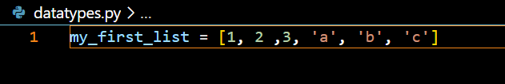
Lists
Simple collection of objects
Uses square braces

Slide 8
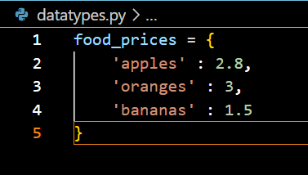
Dictionaries
Mapping between Key Value pairs
Defined using curly braces and key values pairs
All keys must be unique

Slide 9

Tuples
Like a list but you can’t modify it later
Not actually defined by the bracket, defined by the commas

Slide 10
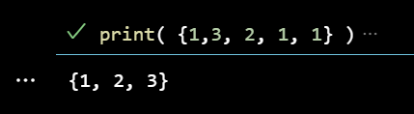
Set
Like a tuple but all elements are unique
Enforces ordering
Defined by curly braces

Slide 11
Task 1
Create a dictionary
Create a list
The list should have at least 3 items
The dictionary should have at least 3 key value pairs
Print both

Slide 12
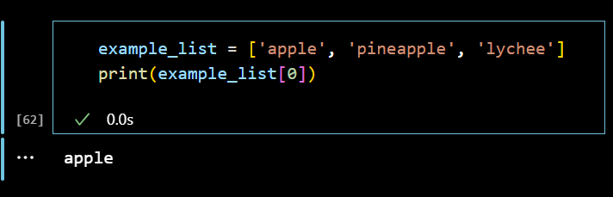
Indexing
Indexing is the process of accessing values from a collection
We index using square brackets
With lists we put an integer into the square brackets for indexing
Python lists are zero indexed meaning the first element is stored at index zero, the second at index 1, etc

Slide 13
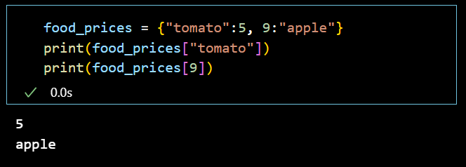
Dictionary Indexing
Dictionaries are indexed using the value of the key
You must use the correct datatype

Slide 14
Task 2
Index into your list and print a value
Index into your dictionary and print a value

Slide 15
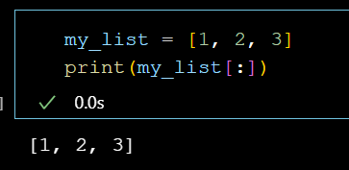
Range indexing
In a list index : means ‘everything’

Slide 16
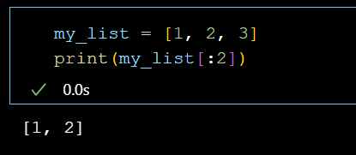
Range indexing
We can also say everything up until a specific index

Slide 17
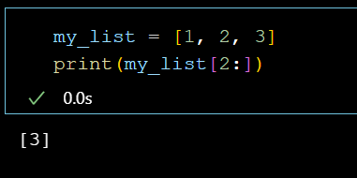
Range indexing
We can also say everything after a specific index

Slide 18
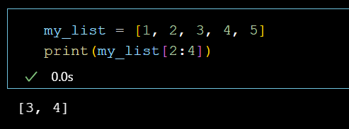
Range indexing
We can combine these and say everything from one index until another

Slide 19
Task 3
Experiment with range indexing

Slide 20
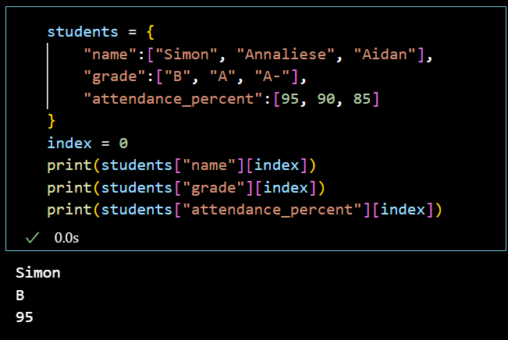
Combining lists and dictionaries
A list can be a dictionary value but not a key

Slide 21
Tuples & Sets
You index into a tuple the same way you index into a list
You can’t index into sets
Try not to use these.

Slide 22
Task 4
Create a dictionary which contains lists as the values
Make sure all the lists have the same length
Try using different indexes to print values from each key
Once finished save this file as we will use it in a future exercise

Slide 23
Other ways of creating collections
Instead of using [] for lists we can use the keyword “list()” and provide a different type of collection
Instead of () for tuples I can use the keyword “tuple()” and provide a different type of collection
Instead of {} and key value pairs for dictionaries I can use the keyword “dict()” and provide a list that contains lists which each contain a key value pair
Instead of {} for sets I can use the keyword “set()” and provide a different type of collection
These are also a useful way of converting between types of collection

Slide 24
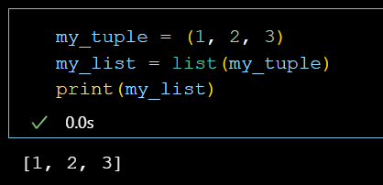
Converting to list
Instead of using [] for lists we can use the keyword “list()” and provide a different type of collection

Slide 25
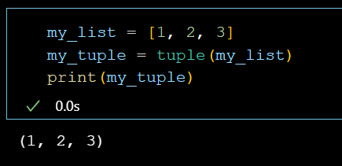
Converting to tuple
Instead of () for tuples I can use the keyword “tuple()” and provide a different type of collection

Slide 26
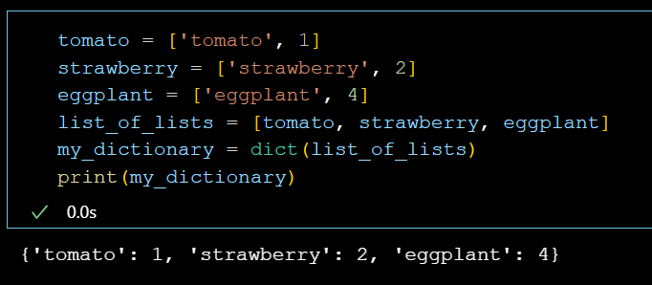
Converting to dictionary
Instead of {} and key value pairs for dictionaries I can use the keyword “dict()” and provide a list that contains lists which each contain a key value pair

Slide 27
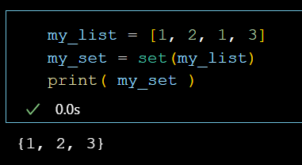
Converting to a set
Instead of {} for sets I can use the keyword “set()” and provide a different type of collection
This is the most useful conversion as it removes duplicates
You can then convert back to list and the duplicates will still be gone

Slide 28
Classes
Collections and Types are datatypes.
Custom datatypes are called Classes
A class is a type of object
Python needs to know to treat different objects differently
Special rules for strings
Special rules for ints
We can create classes with their own special rules
We can create our own classes if we wish
We will discuss this more later

Slide 29
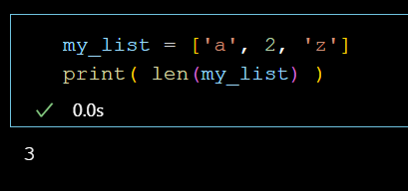
Len keyword
Len is a very useful keyword as it tells us the length of collections and strings
On dictionaries it tells you how many key value pairs there are

Slide 30
Task 5
Try the len keyword on some lists
Try the len keyword on some strings

Slide 31
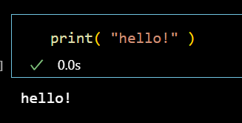
Functions
A block of code assigned to a keyword that will run on specified arguments
A function may or may not return a value
When we create a function we call this defining the function
When we run the function we call this calling the function

Slide 32
Functions
Arguments are provided to a function in the brackets

Slide 33
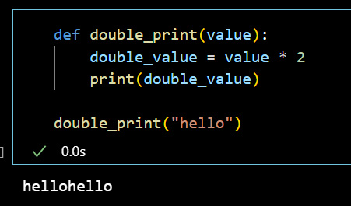
Making our own functions
Functions are defined using the word def followed by the name of the functions
Functions can be named anything, much like variables
Brackets are then used to provide arguments
The body of a function must be indented (we indent with tab)
The function ends when we stop indenting

Slide 34
Task 6
Create your own function
Provide an argument to the function and run it
Do something in the function different to what I did!

Slide 35
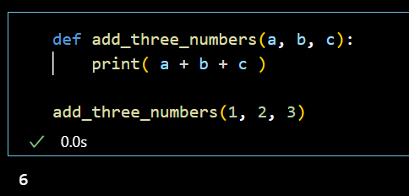
Functions can have multiple arguments

Slide 36
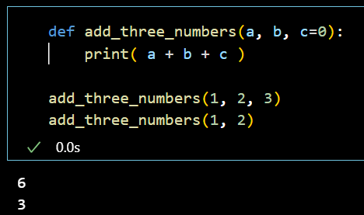
Arguments can be given a default value
If arguments have no default value, they must be specified
Otherwise, they are optional

Slide 37
Arguments can be given a default value
Arguments are either default or non-default
Default must follow non default

Slide 38
Task 7
Add multiple arguments to your function
Give the last argument a default value so that it is optional to specify when calling the function

Slide 39
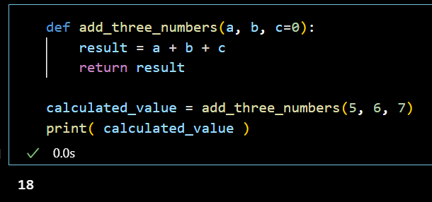
Functions can return values
Using the return key word you can return values

Slide 40
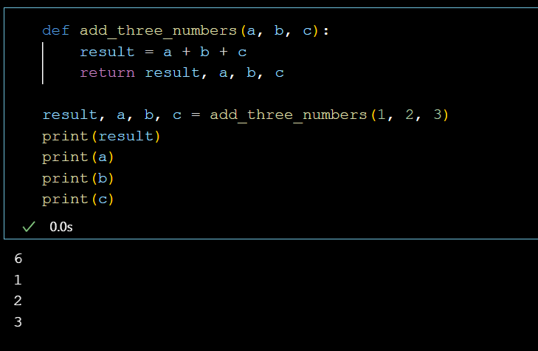
Functions can return multiple values

Slide 41
Task 8
Use the return key word to have your function return a value
Print that value

Slide 42
Function calling
When you define a function you give a name to each argument

Slide 43
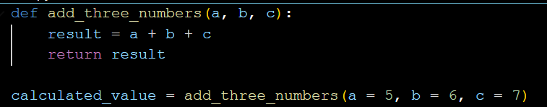
Function calling
When calling the function you can specify arguments by name or order
When you use the name these are called keyword arguments
When using order these are called positional arguments

Slide 44
Function calling
When mixing using positional and keyword arguments, positional arguments must go first

Slide 45
Task 9
Call your function using a mix of keyword and positional arguments

Slide 46
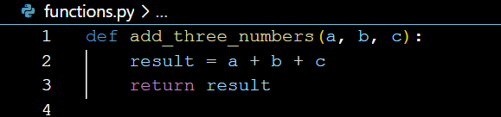
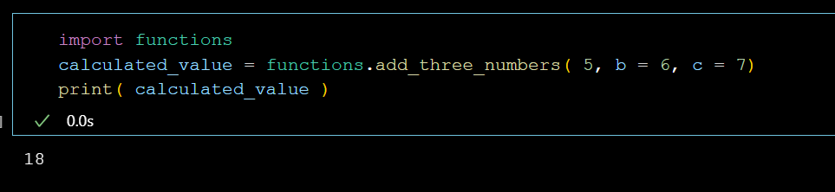
Import statements & libraries
If you create a file and put your functions in it you can import them from a different file
The file can be named anything
You can have as many functions as you want in here

Slide 47
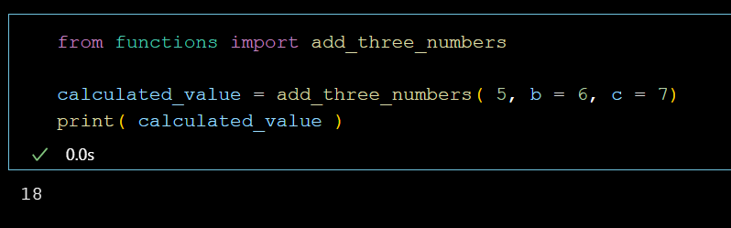
from statement
If you don’t want to import the entire library you can say from library import function

Slide 48
Task 10
Put your function in a python file
Import your function from another python file
Run your function and print the result

Slide 49
Congratulations! You’ve created a library!
A python library is a collection of prewritten code (often including functions)
Libraries have been written for all sorts of purposes and we will use them frequently
Python comes with many built in libraries
Users have created many libraries that can be installed
You can have libraries that consist of many folders and subfolders which each contain Python files but this gets a little more complex

Slide 50
Challenge
If you manage to finish the assignment go to
https://codingbat.com/python/String-1
* Try to finish the ‘hello_name’, ‘first_half’, and ‘make_abba’ exercises

